Slide 1
Hidden Markov Models

Slide 2
Introduction
Modeling dependencies in input; no longer independent
Sequences:
Words in a sentence (syntax, semantics of the language)
Handwriting: pen movements
Speech; phonemes in a word (dictionary)

Slide 3
Patterns
Deterministic Patterns
Traffic Light
Each state dependent only on the previous state
System is Deterministic

Slide 4
Patterns
Non-deterministic Patterns
Weather
States do not follow each other deterministically
Model the system generating these states?
Markov Assumption – State of the model depends only upon the previous states of model
4
Notes:
4

Slide 5
Markov Assumption
Today's weather can always be predicted solely given knowledge of the weather of the past few days
Unrealistic – But simplifies the analysis
5
Notes:
5

Slide 6
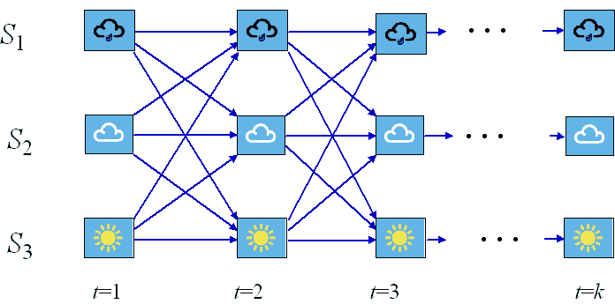
Weather Example
States: S₁: rain; S₂: cloudy; S₃: sunny
Day:

Slide 7
Markov Process
Markov process is a process which moves from state to state depending (only) on the previous n states.
Order n model
n is the number of states affecting the choice of next state
7
Notes:
7

Slide 8
Markov Process
Simplest Markov process
First order process where the choice of state is made purely on the basis of the previous state
How is it different from Deterministic???
Choice to be made probabalistically, not deterministically
8
Notes:
8

Slide 9
Markov Process
M states - M² transitions between states
State transition probability
Probability of moving from one state to another
Collected in state transition matrix
9
Notes:
9

Slide 10
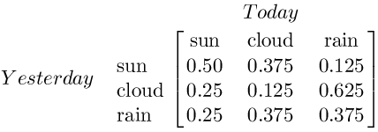
Markov Process
10
Notes:
10

Slide 11
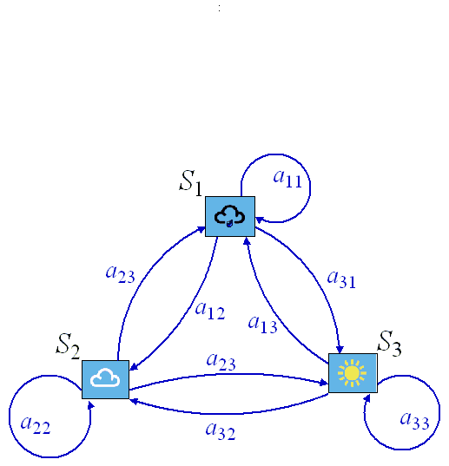
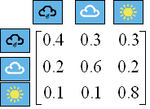
Markov Process
A={a_{i,j}}
a₂₁
a₁₃
a₃₁
3-state Markov model
Transitional probabilities a_{i,j}

Slide 12
Markov Process
Initialization
Vector of initial probabilities π
Sun | Cloud | Rain
1.0 | 0.0 | 0.0
12
Notes:
12

Slide 13
Markov Model
We have defined a first order Markov model comprising
States : Three states - sunny, cloudy, rainy
π vector : Defining the probability of the system being in each of the states at time 0
State transition matrix : The probability of the weather given the previous day's weather
13
Notes:
13

Slide 14
Markov Model
Set of states:
Process moves from one state to another generating a sequence of states :
14
Notes:
14

Slide 15
Markov Model
Markov chain property: probability of each subsequent state depends only on what was the previous state:
To define Markov model, the following probabilities have to be specified:
Transition probabilities
Initial probabilities
15
Notes:
15

Slide 16
Markov Model – Example
0.3
0.7
Rain
Dry
0.2
0.8
Two states : ‘Rain’ and ‘Dry’
Transition probabilities:
P(‘Rain’|‘Rain’)=0.3
P(‘Dry’|‘Rain’)= 0.7
P(‘Rain’|‘Dry’)= 0.2
P(‘Dry’|‘Dry’)= 0.8
Initial probabilities:
P(‘Rain’)=0.4 P(‘Dry’)= 0.6
16
Notes:
16

Slide 17
Calculation of Sequence Probability
Problem:
Calculate the probability of a sequence of states: {‘Dry’,’Dry’,’Rain’,Rain’}
P({‘Dry’,’Dry’,’Rain’,Rain’} ) =
P(‘Rain’|’Rain’) P(‘Rain’|’Dry’) P(‘Dry’|’Dry’) P(‘Dry’) =
0.3*0.2*0.8*0.6
17
Notes:
17

Slide 18
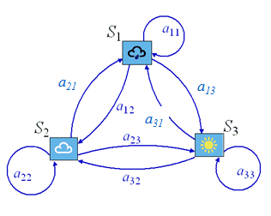
Calculation of Sequence Probability
State at time k is i:
Notation 1
S_{ik}
Notation 2
q_{k} = S_{i}

Slide 19
Calculation of Sequence Probability
On day t=1 the weather is sunny: q₁=S₃.
What is the probability that the weather for the next
7 days will be “sun-sun-rain-rain-sun-cloudy-sun”?
t=1 t=2 t=3 t=4 t=5 t=6 t=7 t=8
Observation sequence: O=S₃,S₃, S₃, S₁, S₁, S₃, S₂, S₃;

Slide 20
Calculation of Sequence Probability
a_{3,3} a_{3,3} a_{3,1} a_{1,1} a_{1,3} a_{3,2} a_{2,3}
P(O)=P{S₃, S_{3,}S₃, S₁, S₁, S₃, S₂, S₃}=
= P(q₁)⋅ P(S₃|S₃)⋅ P(S₃|S₃)⋅ P(S₁|S₃)⋅P(S₁|S₁)⋅P(S₃|S₁) ⋅P(S₂|S₃)⋅P(S₃|S₂)=
=1 ⋅ a_{3,3} ⋅a_{3,3} ⋅a_{3,1} ⋅a_{1,1} ⋅a_{1,3} ⋅a_{3,2} ⋅a_{2,3}=
=1⋅(0.8)⋅(0.8)⋅(0.1)⋅(0.4)⋅(0.3)⋅(0.1)⋅(0.2)=1.54⋅10⁻⁴

Slide 21
Hidden Markov Models
Example
You are locked in a room for several days
You are asked about the weather outside
Only evidence:
Care taker is carrying an umbrella or not
Piece of seaweed
Evidence is somehow linked to the weather
Observed States – Hidden States???
21
Notes:
21

Slide 22
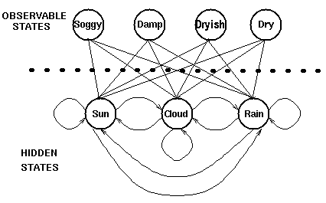
Hidden Markov Models
Probability of generating a particular observed state given that the Markov process is in a particular hidden state
Linked Probalistically
Assumption: Hidden states (the true weather) are modeled by a simple first order Markov process
22
Notes:
22

Slide 23
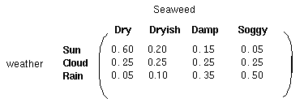
Hidden Markov Models
Matrix of observation probabilities
Contains the probabilities of the observable states given a particular hidden state
23
Notes:
23

Slide 24
Hidden Markov Models
Set of states:
Process moves from one state to another generating a sequence of states :
Markov chain property: probability of each subsequent state depends only on what was the previous state:
24
Notes:
24

Slide 25
Hidden Markov Models
States are not visible, but each state randomly generates one of M observations (or visible states)
25
Notes:
25

Slide 26
Hidden Markov Models
Defining HMM
To define hidden Markov model, the following probabilities have to be specified:
Matrix of transition probabilities A=(a_{ij})
Matrix of observation probabilities B=(b_{i} (v_{m} )),
b_{i}(v_{m} ) = P(v_{m}| s_{i})
Vector of initial probabilities π=(π_{i}), π_{i} = P(s_{i}) .
Model is represented by M=(A, B, π)
26
Notes:
26

Slide 27
HMM – Three Problems
Question # 1 – Evaluation
GIVEN
A sequence of observations:
Dry Dry Dry Rainy Rainy Rainy Dry Rainy
QUESTION
How likely is this sequence, given our model
This is the EVALUATION problem in HMMs
27
Notes:
27

Slide 28
HMM – Three Problems
Evaluation Problem
Given the HMM M=(A, B, π) and the observation sequence O=o₁ o₂ ... o_{K} , calculate the probability that model M has generated sequence O
O=o₁...o_{K} denotes a sequence of observations o_{k}∈{v₁,…,v_{M}}.
28
Notes:
28

Slide 29
HMM – Forward Algorithm Example
Model Description
Hidden States
Sunny, Cloudy, Rainy
Observable States
Dry, Dryish, Damp, Soggy
Initial State Probabilities
 | Sunny | Cloudy | Rainy
π | 0.63 | 0.17 | 0.20
29
Notes:
29

Slide 30
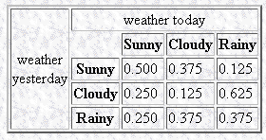
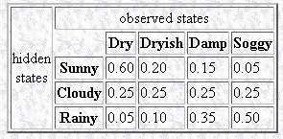
HMM – Forward Algorithm Example
State Transition Matrix A
Observational Probability Matrix B
30
Notes:
30

Slide 31
 | Sunny | Cloudy | Rainy
π | 0.63 | 0.17 | 0.20
Sunny
Cloudy
Rainy
Dry
Damp
Soggy
31
Notes:
31

Slide 32
 | Sunny | Cloudy | Rainy
π | 0.63 | 0.17 | 0.20
0.37800002
Sunny
Cloudy
Rainy
Dry
Damp
Soggy
Alpha₁(Sunny) = (0.63 * 0.6) = 0.37800002
32
Notes:
32

Slide 33
 | Sunny | Cloudy | Rainy
π | 0.63 | 0.17 | 0.20
0.37800002
Sunny
0.0425
Cloudy
Rainy
Dry
Damp
Soggy
Alpha₁(Cloudy) = (0.17 * 0.25) = 0.0425
33
Notes:
33

Slide 34
 | Sunny | Cloudy | Rainy
π | 0.63 | 0.17 | 0.20
0.37800002
Sunny
0.0425
Cloudy
0.01
Rainy
Dry
Damp
Soggy
Alpha₁(Rainy) = (0.2 * 0.05) = 0.010000001
34
Notes:
34

Slide 35
 | Sunny | Cloudy | Rainy
π | 0.63 | 0.17 | 0.20
0.37800002
$$
Sunny
0.0425
Cloudy
0.01
Rainy
Dry
Damp
Soggy
Alpha₂(Sunny) = [Alpha₁(Sunny)* a_{ss} + Alpha₁(Cloudy) * a_{cs} + Alpha₁(Rainy) * a_{rs}] * b_{s,damp}
Alpha2(Sunny) = (((0.37800002*0.5) + (0.0425*0.25) + (0.010000001*0. 25)) * 0.15)=$$
35
Notes:
35

Slide 36
 | Sunny | Cloudy | Rainy
π | 0.63 | 0.17 | 0.20
0.37800002
$$
Sunny
0.0425
££
Cloudy
0.01
Rainy
Dry
Damp
Soggy
36
Notes:
36

Slide 37
 | Sunny | Cloudy | Rainy
π | 0.63 | 0.17 | 0.20
0.37800002
$$
Sunny
0.0425
££
Cloudy
0.01
Rainy
Dry
Damp
Soggy
37
Notes:
37

Slide 38
 | Sunny | Cloudy | Rainy
π | 0.63 | 0.17 | 0.20
0.37800002
$$
$$$
Sunny
0.0425
££
£££
Cloudy
0.01
€€
€€€
Rainy
Dry
Damp
Soggy
Probability of the model = $$$+£££+€€€
38
Notes:
38

Slide 39
HMM – Three Problems
Question # 2 – Decoding
GIVEN
A sequence of observations:
Dry Dry Dry Rainy Rainy Rainy Dry Rainy
QUESTION
Which portion of the sequence was generated by ‘low’ atmospheric pressure and what portion corresponds to ‘high’ atmospheric pressure
This is the DECODING problem in HMMs
39
Notes:
39

Slide 40
HMM – Three Problems
Decoding Problem
Given the HMM M=(A, B, π) and the observation sequence O=o₁ o₂ ... o_{K} , calculate the most likely sequence of hidden states s_{i} that produced this observation sequence O.
40
Notes:
40

Slide 41
HMM – Viterbi Algorithm
Finding the most probable sequence of hidden states
t=1
t=2
t=3
Sunny
Sunny
Sunny
Cloudy
Cloudy
Cloudy
Rainy
Rainy
Rainy
Dry
Damp
Soggy
For each intermediate and terminating state in the trellis there is a most probable path to that state
41
Notes:
41

Slide 42
HMM – Viterbi Alogrithm
Partial best paths each having a probability δ
Unlike the partial probabilities in the forward algorithm, δ is the probability of the one (most probable) path to the state.
42
Notes:
42

Slide 43
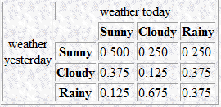
 | Sunny | Cloudy | Rainy
π | 0.63 | 0.17 | 0.20
Sunny
Cloudy
Rainy
Dry
Damp
Soggy
43
Notes:
43

Slide 44
 | Sunny | Cloudy | Rainy
π | 0.63 | 0.17 | 0.20
0.378
Sunny
Cloudy
Rainy
Dry
Damp
Soggy
δ₁(Sunny)=0.63 * 0.6 = 0.37800002
44
Notes:
44

Slide 45
 | Sunny | Cloudy | Rainy
π | 0.63 | 0.17 | 0.20
0.378
Sunny
0.0425
Cloudy
Rainy
Dry
Damp
Soggy
δ₁(Cloudy)=0.17 * 0.25 = 0.0425
45
Notes:
45

Slide 46
 | Sunny | Cloudy | Rainy
π | 0.63 | 0.17 | 0.20
0.378
Sunny
0.0425
Cloudy
0.010
Rainy
Dry
Damp
Soggy
δ₁(Rainy)=0.2 * 0.05 = 0.010000001
46
Notes:
46

Slide 47
 | Sunny | Cloudy | Rainy
π | 0.63 | 0.17 | 0.20
0.378
Sunny
0.0425
Cloudy
0.010
Rainy
Dry
Damp
Soggy
δ₂(Sunny) = ?
47
Notes:
47

Slide 48
 | Sunny | Cloudy | Rainy
π | 0.63 | 0.17 | 0.20
0.378
0.02835
Sunny
0.0425
Cloudy
0.010
Rainy
Dry
Damp
Soggy
δ₂(Sunny)=max ((0.37800002*0.5), (0.0425*0.375), (0.010000001*0.125)) * 0.15 = 0.028350003
Φ₂(Sunny) = Sunny
48
Notes:
48

Slide 49
 | Sunny | Cloudy | Rainy
π | 0.63 | 0.17 | 0.20
0.378
0.02835
Sunny
0.0425
0.02362
Cloudy
0.010
Rainy
Dry
Damp
Soggy
δ₂(Cloudy)=Delta = max ((0.37800002*0.25), (0.0425*0.125), (0.010000001*0.675)) * 0.25 = 0.023625001
Φ₂(Cloudy) = Sunny
49
Notes:
49

Slide 50
 | Sunny | Cloudy | Rainy
π | 0.63 | 0.17 | 0.20
0.378
0.02835
Sunny
0.0425
0.02362
Cloudy
0.010
0.033075
Rainy
Dry
Damp
Soggy
δ₂(Cloudy)=max ((0.37800002*0.25), (0.0425*0.375), (0.010000001*0.375)) * 0.35 = 0.033075
Φ₂(Rainy) = Sunny
50
Notes:
50

Slide 51
 | Sunny | Cloudy | Rainy
π | 0.63 | 0.17 | 0.20
0.378
0.02835
Sunny
0.0425
0.02362
Cloudy
0.010
0.033075
Rainy
Dry
Damp
Soggy
51
Notes:
51

Slide 52
 | Sunny | Cloudy | Rainy
π | 0.63 | 0.17 | 0.20
0.378
0.02835
Sunny
0.0425
0.02362
Cloudy
0.010
0.033075
Rainy
Dry
Damp
Soggy
52
Notes:
52

Slide 53
HMM – Three Problems
Question # 3 – Learning
GIVEN
Sequence(s) of observations:
Dry Dry Dry Rainy Rainy Rainy Dry Rainy
And possible hidden states
Low Pressure, High Pressure
QUESTION
How the hidden states are linked to the observable states? How often pressure changes from low to high etc.
This is the LEARNING problem in HMMs
53
Notes:
53

Slide 54
HMM – Three Problems
Learning Problem
Given some training observation sequences O=o₁ o₂ ... o_{K} and general structure of HMM (numbers of hidden and visible states), determine HMM parameters M=(A, B, π) that best fit training data
54
Notes:
54

Slide 55
Supervised Training
If training data has information about sequence of hidden states then use maximum likelihood estimation of parameters:
a_{ji}= P(s_{i} | s_{j}) =
Number of transitions from state s_{j} to state s_{i}
Number of transitions out of state s_{j}
Number of times observation v_{m} occurs in state s_{i}
Number of times in state s_{i}
b_{i}(v_{m} ) = P(v_{m} | s_{i})=

Slide 56
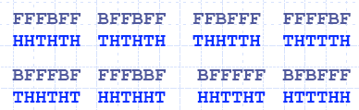
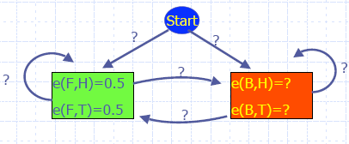
Supervised Training
Count transition frequencies
Start Fair = 4
π_{fair} = 4/8 = 0.5
Fair Biased = 7
a(Fair, Biased) = 7/(4+3+4+4+3+3+4+3) = ¼
{F⇒B} transitions occur at 7 locations (1₃,2₃,3₂,4₄,5₄,6₃,8₂) where k_{i} denotes location i of sequence k

Slide 57
Supervised Training
Observation/Emission Frequencies
E(Biased, Head) = 8
e(Biased, Head) = 8/12

Slide 58
The material in these slides is based on the following resources
References
A tutorial on Hidden Markov Models by Roger Boyle, University of Leeds
Chapter 13, Introduction to Machine Learning, E. Alpyadin, MIT Press
Hidden Markov Models by V. Govindaraju
Hidden Markov Models by Y. Yemini, Columbia University

